Slide 1
Practical: Airborne Infection Risk
Session objectives
Introduce disease dynamics and transmission modelling
Introduce the parameters that affect airborne transmission and Wells-Riley model
Demonstrate how it can be coupled with SEIR models
Use simple spreadsheet models to explore the effect of parameters and interventions
Notes:
2017-18
CIVE 5370M Indoor and Urban Air Quality

Slide 2
Disease Transmission
Source
Recipient
Infectious microorganism
Hazardous substance
You
Human behaviour
The environment

Slide 3
Disease Dynamics
Spread of disease depends on many factors:
  The pathogen concerned - virilence, survival
  The population of people and their susceptibility to the disease
  The mode of transmission
  The time between being exposed to the disease and becoming infectious
  The symptoms
  The ability and ease of passing the disease on
  .............................

Slide 4
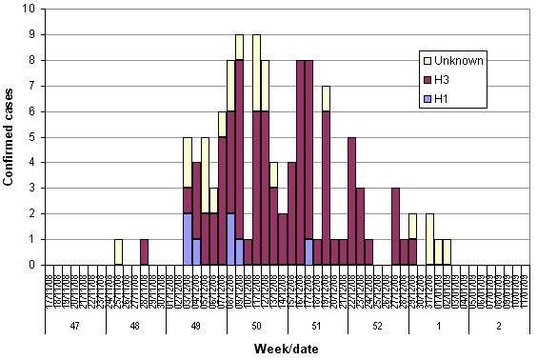
Outbreak patterns
Royal Liverpool University Hospital, and influenza-like illness rates in Liverpool between week 47/2008 and week 2/2009
HPA, www.hpa.org.uk/hpr/archives/2009/news0509.htm

Slide 5
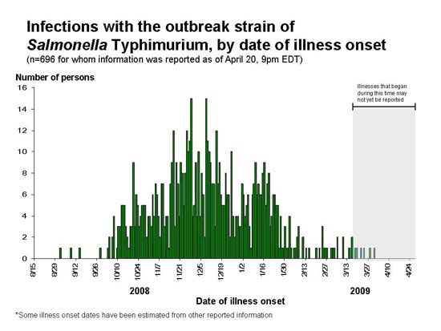
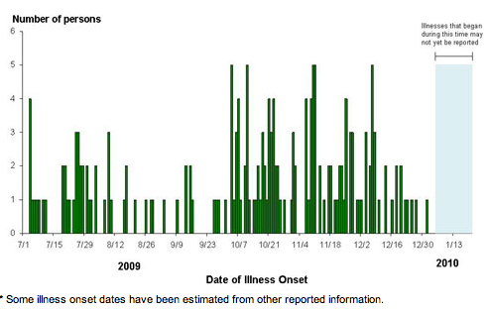
Outbreak patterns
CDC: www.cdc.gov/salmonella/typhimurium/epi_curve.html

Slide 6
Modelling disease transmission
Models allow assessment of the relative importance of disease parameters
Describe the progression of disease over time
Enable intervention or response to disease
Earliest model – Daniel Bernolli, vaccination against small pox
Modern approaches based on models of Reed and Frost (1920’s) and McKendrick and Kermack (1927)

Slide 7
Model requirements
Will an infection spread?
How fast will it spread?
How many people will be affected?
How long will the outbreak last?
What interventions are the most effective?
In air – how does the building and human breathing ventilation affect risk?

Slide 8
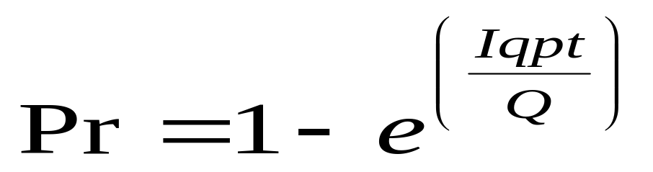
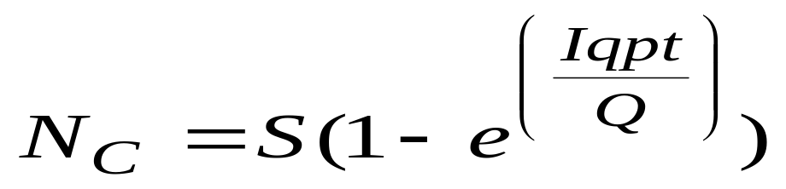
Wells-Riley Model
Probability of infection (Pr) linked to disease, occupant and ventilation characteristics
Usually used to model new infections (N_{C}) for S susceptibles
  Q = ventilation rate (m³/s)
  P = breathing rate (m³/s)
  I = number of infectors
  S = number of susceptibles

Slide 9
Quanta (q)
Rate of generation of “infectious doses”
Encompasses concentration, virilence, host susceptibility
Used in wide range of risk analysis studies and assessment of disease outbreaks
Usually estimated from past outbreak data – but not always reliable

Slide 10
Infectious Dose
Disease | Case | Quanta/h | Reported by
TB | Average TB patient | 1.25 | Nardell et al (1991)
TB | Outbreak in office building | 12.7 | Nardell et al (1991)
TB | Human to guinea pig transmission | 0.3-44 | Escombe et al (2007)
MDR TB | Human to guinea pig transmission (highest infectors) | 40,52,226 | Escombe et al (2008)
Measles | Outbreak in a school | 570 | Rudnick &Milton(2003)
Influenza | School cases in Taiwan | 66.91 (LN*) | Liao et al (2005)
Influenza | Aircraft outbreak | 79-128 | Rudnick &Milton(2003)
SARs | Taipei Hospital outbreak | 28.77 (LN*) | Liao et al (2005)
Rhinovirus 16 | Experimental data of Dick et al 1987 | 1-10 | Rudnick &Milton(2003)

Slide 11
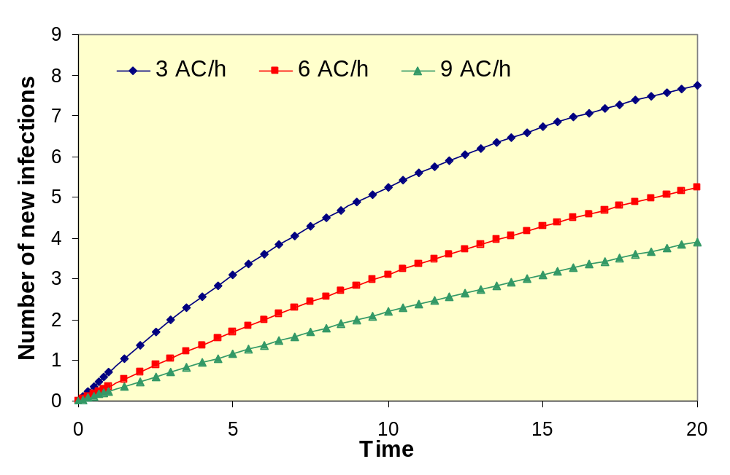
Wells-Riley Results
Fully mixed room: 10 susceptibles, 1 infector, 12 quanta/hr,
10 l/min pulmonary ventilation, 32.25 m³ room

Slide 12
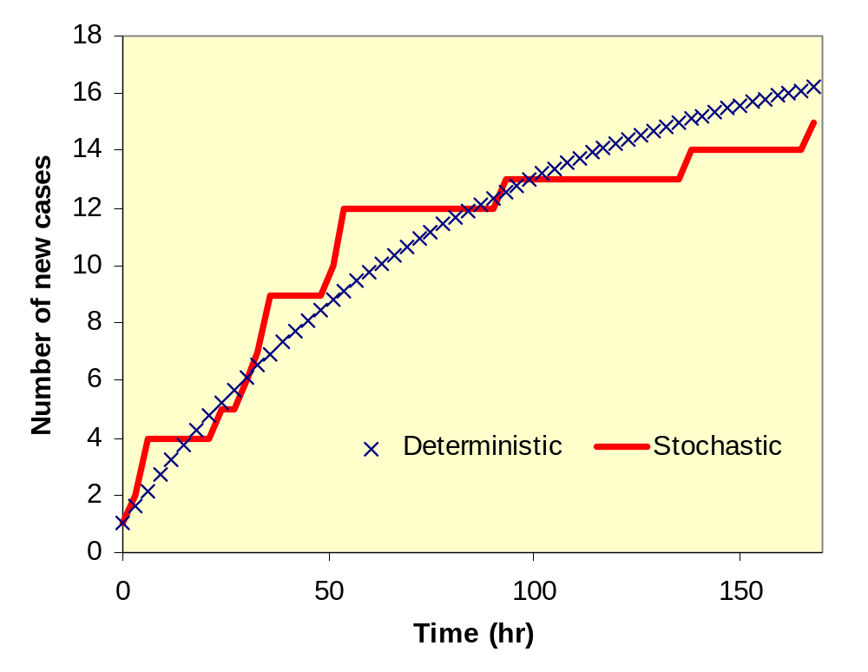
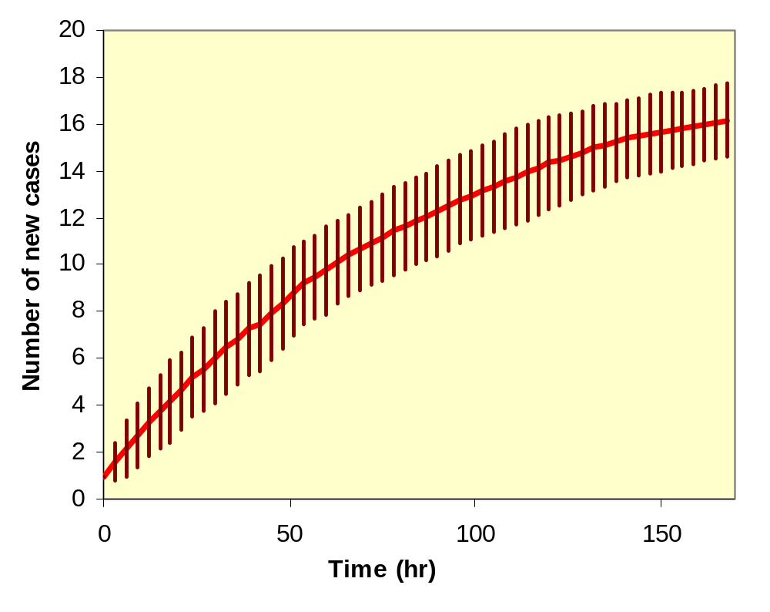
Stochastic Effects

Slide 13
Epidemic models
Contact rate, β
Susceptible
Infector
Removed
Removal rate, γ

Slide 14

SIR Deterministic Formulation
For a closed population of N people – no increase or decrease eg. Birth rate
Assume homogeneity - every person has the same probability of infection, with contact rate β
People recover at a rate γ = 1/duration of infection
Consider rate of transition between states
Expressed as ordinary differential equations

Slide 15
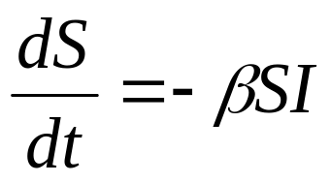
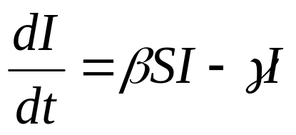
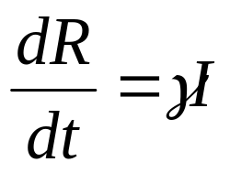
SIR Deterministic model
Rate susceptibles become infectious
Rate infectors change = new infectors – those who recover/are removed
Rate infectors recover/are removed
Numerical solution is straightforward

Slide 16
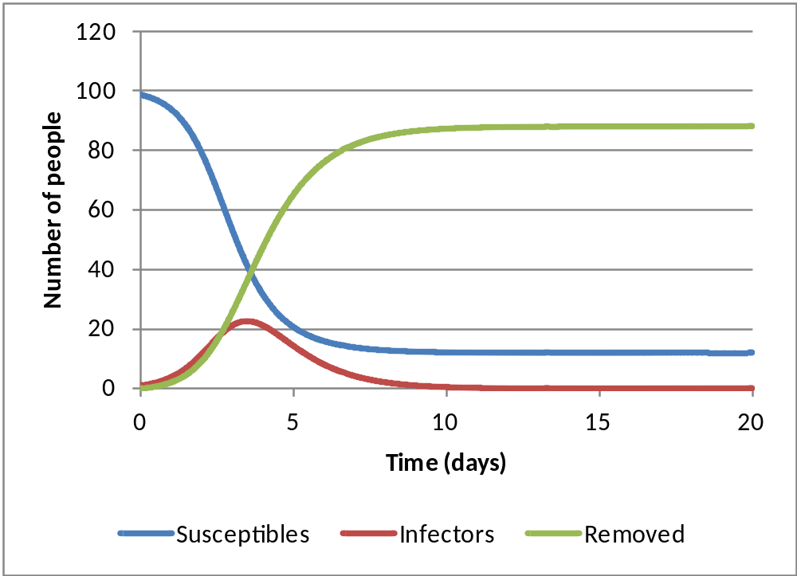
SIR outputs

Slide 17
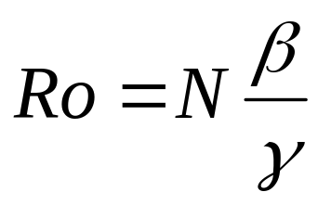
Reproduction rate
Measure of rate of spread of an infection
Ro < 1: infection will die out
Ro > 1: infection will spread through
Ro = 1: Epidemic threshold
Can estimate from
Ro = number of secondary cases produced by an infector

Slide 18
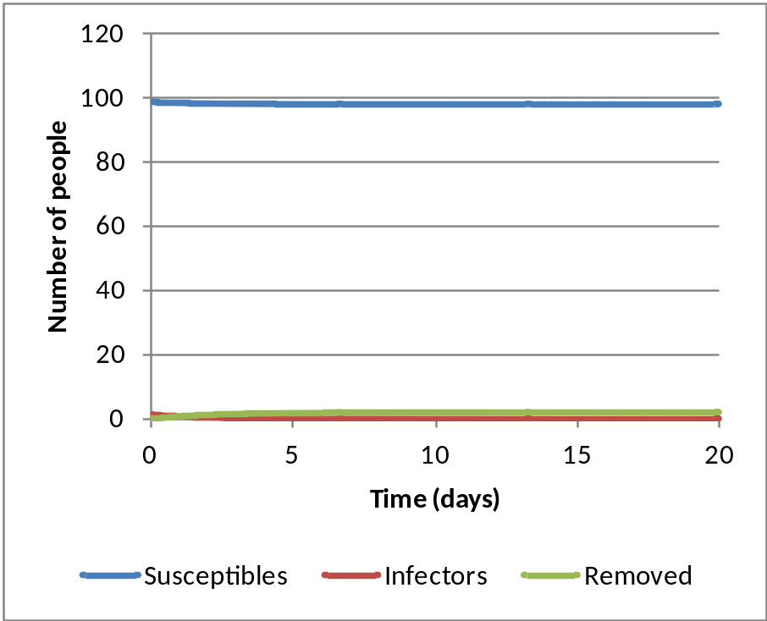
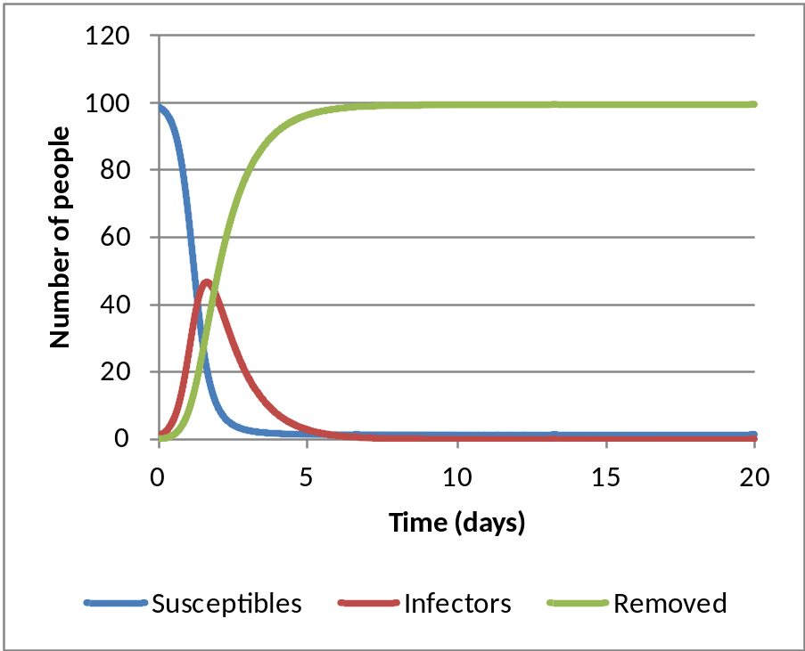
Epidemic threshold
Ro < 1
Ro > 1

Slide 19
SEIR Models
Most common variant on SIR model
Acknowledges that most diseases have an incubation period between exposure and becoming infectious
Incubation period
Susceptible
Exposed
Infectious
Removed
β
1/α
γ

Slide 20
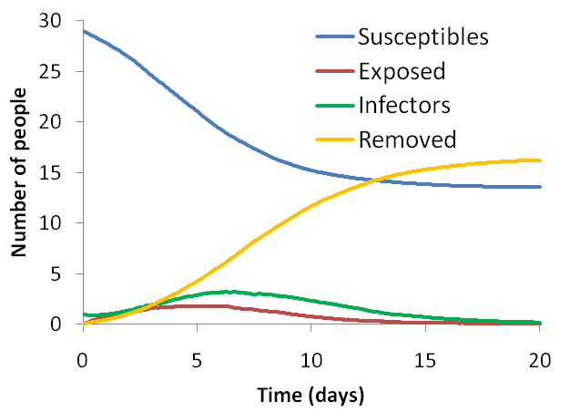
SEIR Outputs

Slide 21
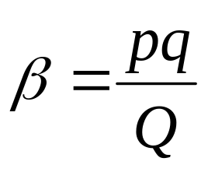
Linking air and epidemic models
Wells-Riley developed for TB – generally long incubation period
Can be applied to short incubation infections such as influenza, SARs etc.
Contact rate determined by air flows and breathing rate
Can use to estimate effectiveness of environmental controls

Slide 22
Activity
In groups or individually:
Use the spreadsheet models provided to explore how changes to disease parameters and the environment affect outbreaks
Use the models to evaluate the scenarios described

